Slide 1

Computers that get better with age?
Using machine learning ideas to speed up operating systems.
Russ Seaman

Slide 2
Quick poll
Students with cellphone that are older than
6 mos old
9 mos old
1 yr old
1.5 yr old
Older than 2 years
What are the major deterring factors from upgrading?

Slide 3
Moore’s law is slowing down!
Fundamental design of chips has not changed in recent years.

Slide 4
Trend that is going from tall to wide
Hardware is no longer making the big leaps we used to see 10-20 years ago. Strong emphasis on power consumption and efficiency.
No longer just about size or raw horsepower of computer components.

Slide 5
What actually is machine learning?
“Machine learning is a subset of AI. One aspect that separates machine learning from the knowledge graphs and expert systems is its ability to modify itself when exposed to more data; i.e. machine learning is dynamic and does not require human intervention to make certain changes. That makes it less brittle, and less reliant on human experts.”

Slide 6
“We tend to build general-purpose systems and hardware, Machine learning makes it possible that the system is automatically customized, to its core, to the specific data and access patterns of a user.”
-Tim Krashka (Associate professor, MIT)

Slide 7
prefetching
Computers process information much faster than they can pull it from memory to be processed. To avoid bottlenecks, they try to predict which information is likely to be needed and pull it in advance.
As computers get more powerful, this prediction becomes progressively harder.

Slide 8
Background
Stride Perfecters (Microarchitectural Data Prefetchers)
Given access pattern that adds for to memory address every time (0,4,8,12)
Will learn the delta (∆) and try to prefetch ahead of time of the demand, will open parallel access to potential future address targets (16,20,24) up to specified distance
Recurrent Neural Networks
Very similar to Neural Networks we studied in AI
Inputs go through NN to produce a desired output.
Long Short Term Memory (LSTM)
Current type being used
Really good at remembering things for long periods of time

Slide 9

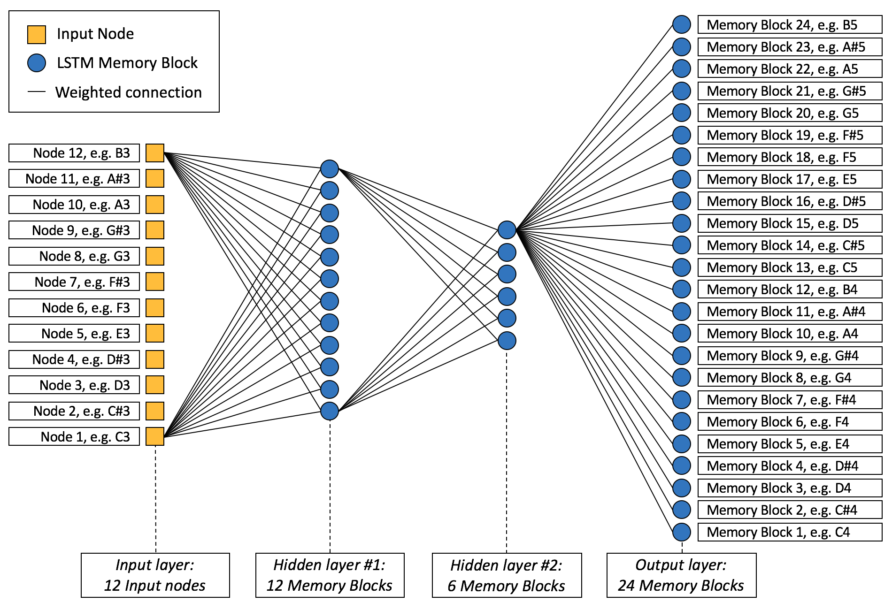

Slide 10
Applications of this technology
Servers (Database)
Operating Systems (Computer | Phone)
Embedded systems (IoT)

Slide 11
Basic Concept of how this would work
Very early development phase of this idea and how it would actually function.
Using Machine Learning, a computer redirect resources to different components as needed.
Basically the computer would fine tune it self to current needs of tasks.

Slide 12
Current work by google
Google is currently working on using AI to speed up prefetching
Have noted a significant improvement in the prefetching times and process
Big issues can arise because a highly optimized AI might fetch too much data, possibly clogging up cache.

Slide 13
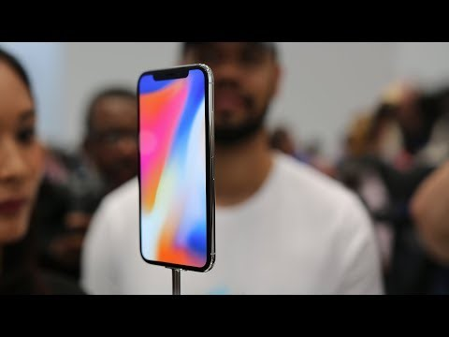

Slide 14
SourCes:
https://www.technologyreview.com/s/610453/your-next-computer-could-improve-with-age/
http://www.digitaljournal.com/tech-and-science/technology/google-uses-machine-learning-to-make-computers-faster-as-they-age/article/517319

